Slide 1

InvestNext
by Team (Aisana, Monesha, Maya, Faustine, Jialing):
Part of Athena Hackathon 2022

Slide 2
Theme Choice: Financial inclusion
availability and equality of opportunities to access financial services.
a process by which individuals and businesses
can access products and services that are:
Appropriate
Affordable
Relevant
Products and services:
Banking
Loan
Equity
Insurance products
Accessibility

Slide 3
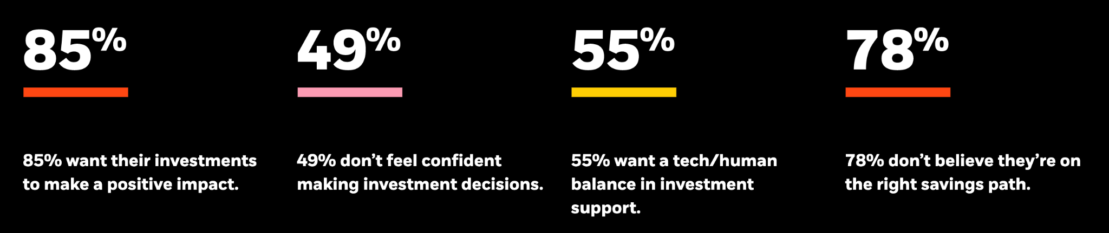
Background Research
A third of adults around the world still remain unbanked: whether it’s women who rely on their partner for finances or minorities which don’t have access to banking.
Among those who bank, it is still difficult for people to find guidance on investment and is intimidating for people to make confident decisions. According to a report by Blackrock, among 26k people who have history investing, 49% of them are not confident in making decisions, 55% of them need extra guidance..
In addition, financial markets are rapidly changing, with developments in technology and new financial products. It is hard for people to keep up with the changes and make according changes in investment decisions.
Notes:
Financial literacy https://www.investopedia.com/terms/f/financial-literacy.asp Blackrock report https://www.blackrock.com/corporate/insights/people-and-money#sustainability

Slide 4
Problem Statement
!
Lack of financial literacy among range of people
Financial Literacy: the ability to do personal financial management, budgeting, and investing (important aspect in every life)
Inefficient teaching/information solutions provided by banks
Long vague terms/documents, difficult terminology
Causes indecisiveness
Additional expenses spent on consultations with professionals
Notes:
Wider audience with no/few financial literacy have difficulties with personal investment in the stock market. In particular, many existing sources/references are too hard/lengthy for them to understand in short amount of time, and some are unconfident about making a decision on which stock to invest.

Slide 5
Our Solution Idea:
Build application that helps users to make smart and deliberate financial decisions
Application Aim:
allow users to compare and understand various investments opportunities in the simplest way
make conscious choice of investment (recommend stock investment options)
learn key criteria to focus on when selecting investment
provide constant/real-time updates of investment
Notes:
make predictions/evaluate stock based on past stock indices

Slide 6
Unique Selling Point
Trading platform provide difficult to read data. Although any platform could start selling more simplified information, they haven’t yet. Our uniqueness is in the fact we provide the most basic information and present it in a meaningful way that does not overload the user with irrelevant information. This app could partner up with existing trading platform to provide them with a new view.

Slide 7
User persona
Beginner
New to investment
Has little knowledge about investments
Find it hard to make decisions about investments to choose
Ex: Bob is a recent graduate, he works 9-6 and doesn’t have much free time but still wants to invest in appropriate options
Experience
Need up-to-date aggregated information
Have time constraints
Ex: Alice has some experience in investing but wants an easy way to view the options that will best meet her needs
Notes:
Eg Laura Young students / new starters
People who find it hard to make investment decisions.
For anyone who’s ever been intimidated by personal finances.
Among those which do have access to bankings, many people still don’t understand any of the products which banks offer.
Individuals new to investing (simplicity); everyday person (time constraints: needs to be quick and easy); People who are seeking financial independence (simplicity)

Slide 8
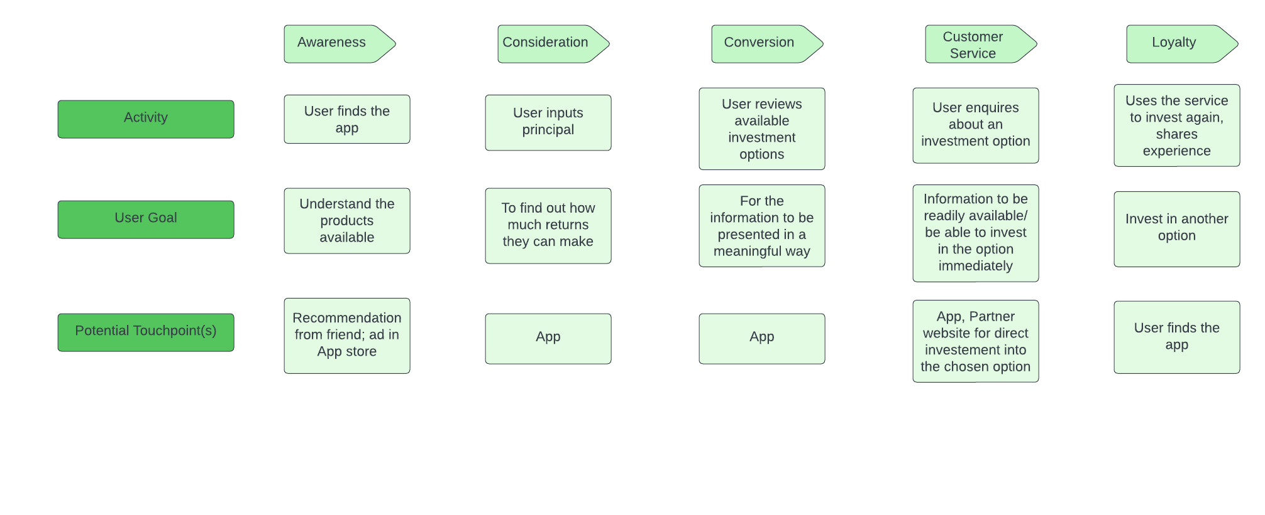
User Journey - Beginner (Bob)

Slide 9
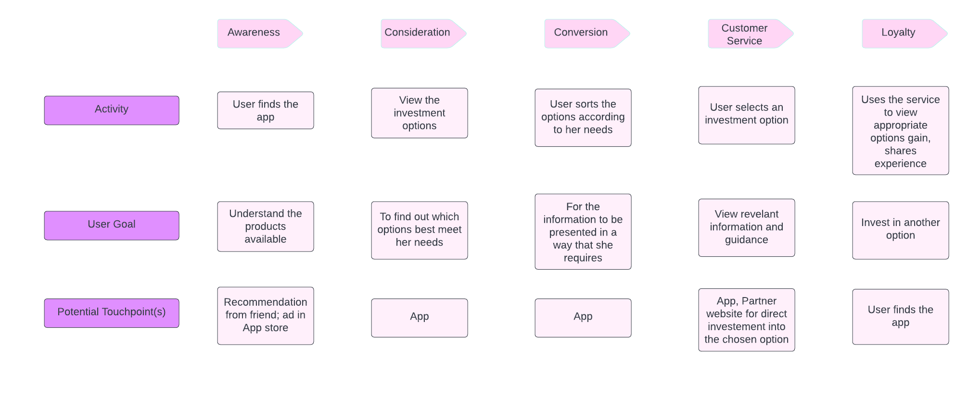
User Journey - Experience (Alice)

Slide 10
Main Functions
Allow the users to input amount and duration they want to invest
Connect to market data APIs and gather information about the products/equities offered (backend)
See a list of investments
Show the amount they will earn after a set number of years
Rank the results with bar chart visualisations in the order of users’ preference
Change the ranking/sorting options according to users’ preference
Provide recommendations and external resources under bar charts
Sorting options
IRR, risk, quality
General
Notes:
Enter user situation: Investment and Duration (user is looking into)
Be able to view options in years (long) and months(short) periods
See a list of investments
Show calculated sample output of investment result with given user information
Wider audience with no/few financial literacy have difficulties with personal investment in the stock market. In particular, many existing sources/references are too hard/lengthy for them to understand in short amount of time, and some are unconfident about making a decision on which stock to invest.

Slide 11
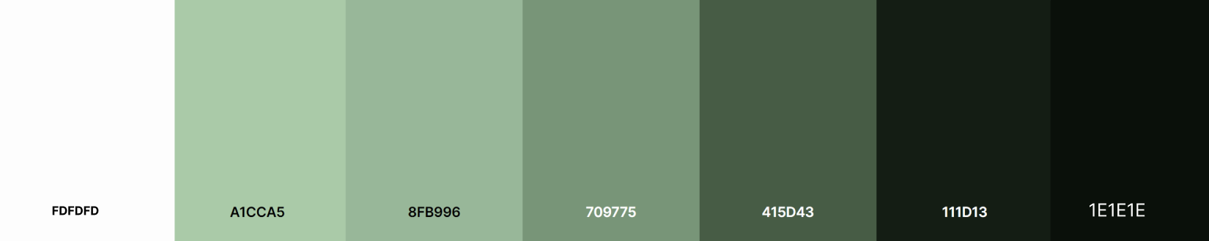
Colour Scheme
The green colour palette
have an association with money, investment and nature
we want the customer to feel relaxed and do this naturally - instead of getting intimidated with the unknown

Slide 12
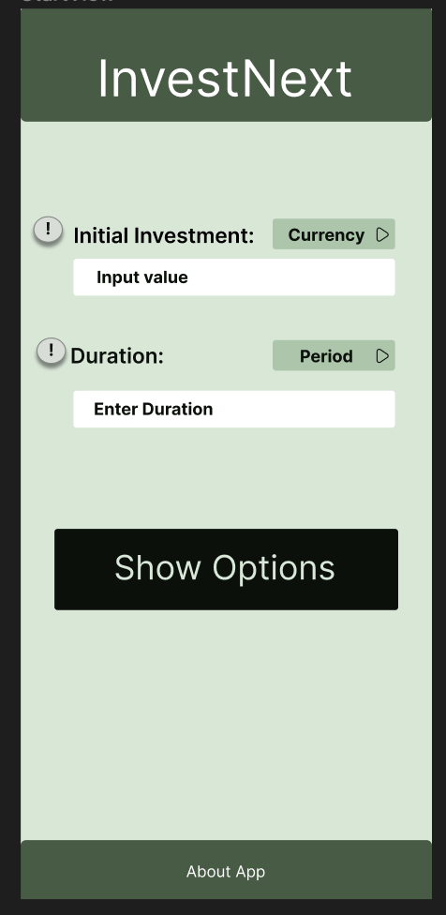
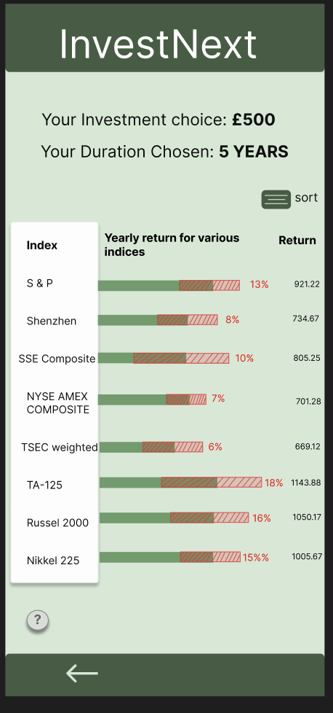
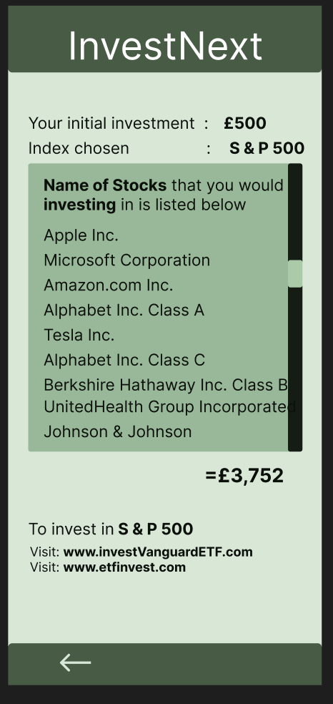
Wireframe

Slide 13

App Prototype Demo
Link: https://drive.google.com/file/d/1hiUyveJyxXtdaPeD9yApOKajcUMWPpot/view?usp=sharing

Slide 14

Business Idea:
Generate revenue from investors: providing a platform for share issuers to redirect end users to their website
Those counterparties could pay a fee for us bringing them new clients through the advertising of their issued shares
Add a ‘tutorial/course’ tab at the bottom which includes investment posts, blogs & tutorials. Online platforms/organizations (eg udemy) could add their courses, learning platforms on it by paying a fee

Slide 15
Further development ideas:
Provide user tutorial the first time users enter the app
Timely market data may be expensive: a partnership with providers to negotiate for more general/cheaper pipelines would help reduce costs
In the future: offer a wider range of asset classes for investments (fixed income for e.g.)
Provide a direct platform which people can invest on which centralises different ETFs and stock issuers
Or/And partner up with existing investing platforms to provide them with a service they can offer their customers as a “simplified investment view”
Propose a way to build portfolios depending on their choice of strategy: momentum, mean-variance, value…
Notes:
generate revenue from investors: providing a platform for share issuers to redirect end users to their website
those counterparties could pay a fee for us bringing them new clients through the advertising of their issued shares
timely market data may be expensive but could work to negotiate for more general/cheaper pipelines with providers to reduce costs
Next steps: - offer a wider range of asset classes for investments (fixed income for e.g.) (edited)
provide a direct platform which people can invest on which centralises different ETFs and stock issuers
Provide user tutorial the first time users use the app
Allow the users to choose category of stocks they want to invest in

Slide 16
Security Considerations
!
Mobile App Security:
Source code encryption
High-level authentication and authorisation
Network configurations: HTTPS/TLS
User Security Considerations:
ID Verification: Age check over 18
Password policies
Further development:
Residential Tax Address checks
High level authentication because investing directly in the app
API Authentication: getting live option trend updates
Notes:
Wider audience with no/few financial literacy have difficulties with personal investment in the stock market. In particular, many existing sources/references are too hard/lengthy for them to understand in short amount of time, and some are unconfident about making a decision on which stock to invest.

Slide 17
Thank you!
https://github.com/fausteire/AthenaHackathon

